Slide 1



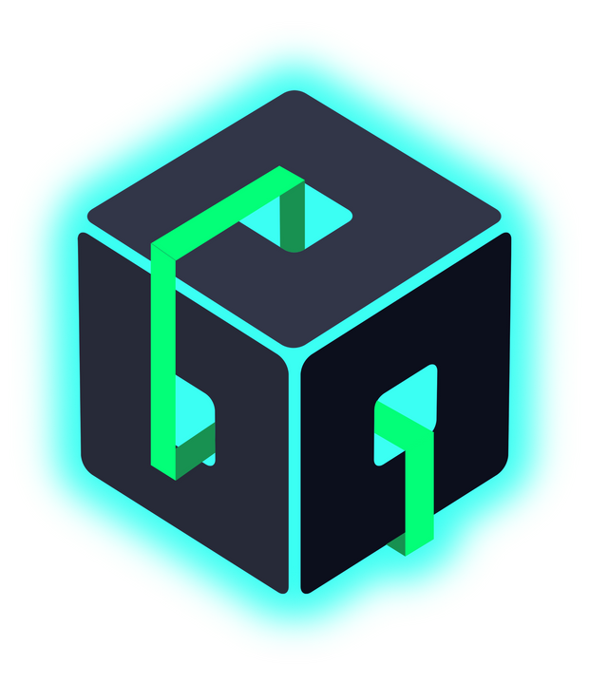

WELCOME
CATCHING 🔥 WIRE
Build modern, reactive applications in record time without building backend APIs
Into the Box 2025: The Future is Dynamic!
LET’S GET STARTED
www.intothebox.org

Slide 2
?
Stuck in legacy limbo? What if you could evolve your coldbox app without breaking the bank or the codebase?
www.intothebox.org
Notes:
They say I should start with a question that will get your attention and that is usually best to actually answer that question

Slide 3
“
Every once in a while, a new technology, an old problem, and a big idea turn into an innovation.
~ Dean Kamen
💡 American engineer, inventor, and businessman 💡 Inventor of the Segway and iBOT
www.intothebox.org
Notes:
I also love quotes so here's a good one
This could apply to many box products ... BoxLang ... in this case I'm thinking about CBWIRE.

Slide 4
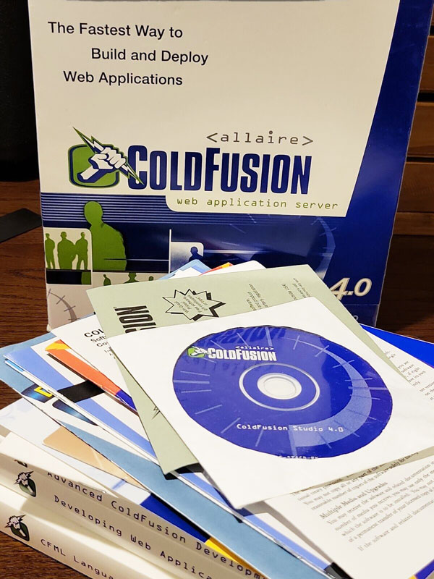











Senior ColdFusion Developer
Michael Rigsby
Owner, OIS Technologies
mrigsby@oistech.com
@mike-rigsby
@mrigsby
@michael.rigsby.9
Live in Severn Maryland with my wife, many dogs and one cat
Multiple contributions to CBWIRE including Checksum and Locked data properties
Developing ColdFusion Apps since version 4.0 (since last century ;-)
Notes:
The obligatory self intro
Animation : CF 4.0 Box

Slide 5



Demo ColdBox App
https://github.com/mrigsby/CatchingWire
Notes:
The plan, time permitting is to go through a few slides here to quickly talk about CBWIRE then get into some examples and code
You can download the repository including the demo coldbox app and this Power Point.
It has fairly good instructions on getting it up and running
links to all the modules, tools etc. I used.

Slide 6


What is CBWIRE ?
CBWIRE is a ColdBox module utilizing Livewire.js and Alpine.js to enable developers to create dynamic, interactive user interfaces using all the benefits of the ColdBox MVC framework and reduces the need for extensive JavaScript, making it easier for developers to build responsive web applications without full page reloads, or building new backend APIs.
Notes:
ColdBox module
Livewire.js and Alpine.js
Create dynamic, interactive user interfaces
all the benefits of the ColdBox MVC framework
reduces the need for extensive JavaScript
build responsive apps without full page reloads, JavaScript or building backend APIs.

Slide 7
Some Benefits of CBWIRE ?
CBWire Simplifies Development
CBWIRE simplifies development by leveraging familiar CFML, offers real-time updates for a responsive user experience, and optimizes performance through efficient DOM updates. It also integrates seamlessly with ColdBox, preserving form states and reducing the learning curve for developers
Notes:
- simplifies development
- leverages familiar CFML
- real-time updates for a responsive user experience
- optimizes performance through efficient DOM updates.
- integrates seamlessly with ColdBox
- reducing the learning curve for developers
??? Anyone here heard of or have used Livewire or Alpine.js ???

Slide 8
Some Benefits of CBWIRE ?
No Need for Extensive Javascript
CBWIRE uses Livewire.js, developed for Laravel that lets developers build dynamic web pages with less JavaScript. Instead of writing complex client-side code for tasks like updating the UI or handling form submissions, Livewire.js handles the interaction with the server. It automatically updates the DOM, so you don’t need to write JavaScript for events or AJAX calls, making development simpler and faster
Notes:
uses Livewire.js, developed for Laravel
Developers can build dynamic web pages with less JavaScript.
Handles client-side code for tasks like updating the UI or handling form submissions
Livewire.js handles the interaction with the server
automatically updates the DOM
No need to write JavaScript for events or AJAX calls

Slide 9
Some Benefits of CBWIRE ?
Livewire.js includes Alpine.js
Alpine.js complements Livewire.js by helping to handle client-side interactions, like real-time form validation or toggling UI elements, without needing a server request. This partnership reduces JavaScript needs further, as Alpine.js is lightweight and easy to use. Together, they offer responsive, instant feedback, enhancing user experience and performance.
Notes:
Livewire.js ( and alpine.js) handle client-side interactions,
real-time form validation
toggling UI elements
Alpine.js is lightweight and easy to use.
Together, they offer responsive, instant feedback, and an enhanced user experience and performance.

Slide 10
Some Benefits of CBWIRE ?
DOM Morphing
DOM morphing is a critical feature. It involves comparing the current DOM in the browser with the newly rendered HTML from the server after a component update. Instead of replacing the entire DOM, Livewire identifies differences and applies surgical changes, preserving existing elements including items such as event listeners, focus states, and form input values.
Notes:
With HTML over the wire DOM morphing is key
compares the current DOM in the browser with the newly rendered HTML from the server
Instead of replacing the entire DOM, Livewire identifies differences
applies surgical changes, preserving existing elements like event listeners, focus states, and form input values.

Slide 11
Anatomy of a “WIRE”
A “wire” is made up of a wire component and a wire template.
Wire Component (Model)
/wires/Counter1.cfc
Wire Template (View)
/wires/counter1.cfm
www.intothebox.org
Notes:
A wire is typically consists of two files
The Wire Component (Model)
The wire Template (View)
I like to think of cbwire as the handler

Slide 12
Anatomy of a “WIRE”
Wire Component (Model)
/wires/Counter1.cfc
component extends="cbwire.models.Component" {
// Data properties
data = {
"counter" : 0 // default value
};
// Action
function increment(){
data.counter++;
}
}
www.intothebox.org
Notes:
- Extends the base CBWIRE component
- Define data properties
- Define actions (functions)

Slide 13
Anatomy of a “WIRE”
Wire Template (View)
/wires/counter1.cfm
<cfoutput>
<div class="wireOuterWrapper">
<div> Count: #counter#
</div>
<button wire:click="increment">+</button>
</div>
</cfoutput>
www.intothebox.org
Notes:
By convention, they have the same name with a .cfc and .cfm.
The wire MUST only have ONE outer element
Note: the class wireOuterWrapper is added by me. Used to highlight the outer wrapper in all the demos to clearly demonstrate the wire element
Animation 1 : We output the counter value. All data properties are injected into the variables scope but you can also use data.counter
Animation 2: We use a wire directive,
The wire:click attribute on the button directs livewire to run the increment() action in our wire component when clicked
There are many wire directives and we will discuss a few other in little bit

Slide 14
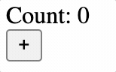
How do we use our “WIRE”?
Place our wire in a ColdBox view or layout
/views/wiredemos/counter1.cfm
<cfoutput>
#wire( "Counter1" )#
</cfoutput>
www.intothebox.org
Notes:
We display our wire on a page by using the wire() function available in views and layouts
Here is the result of our basic counter

Slide 15
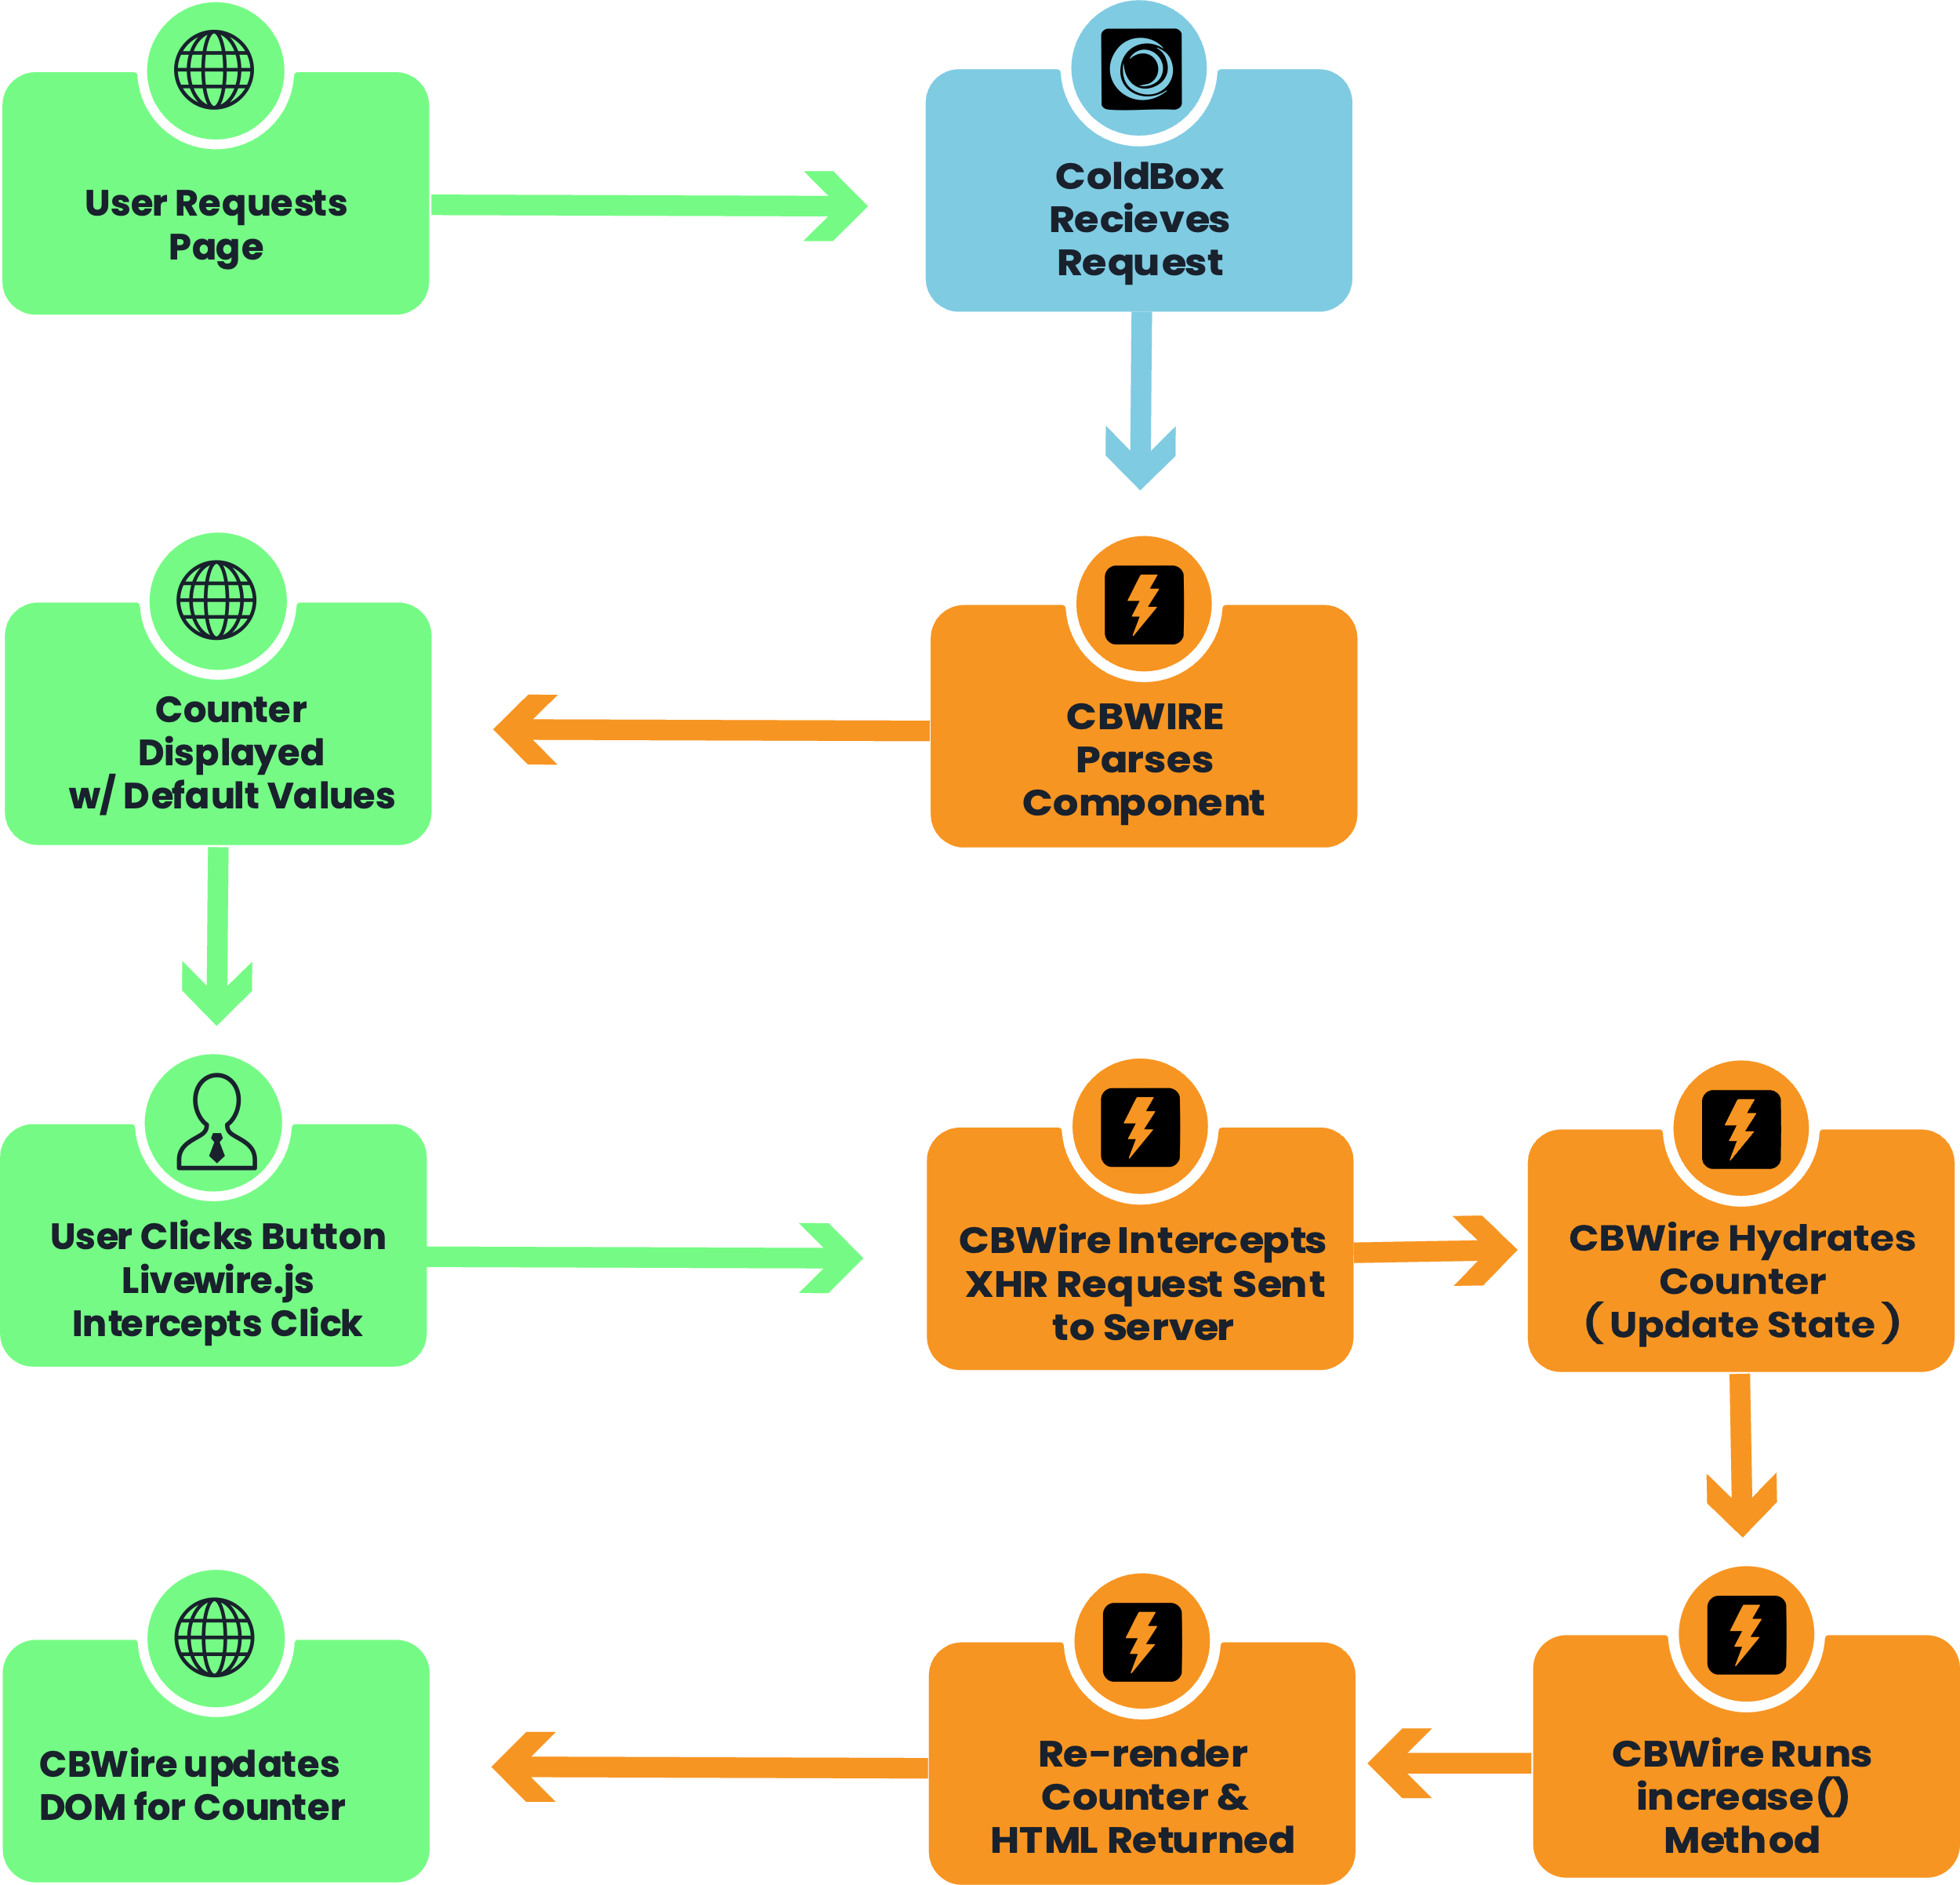

What's Going On
CBWIRE Counter Component Interaction
CBWIRE Parses Component
User Clicks Button & Livewire.js
Intercepts Click
CBWIRE Updates DOM for Counter1
Counter Displayed w/ Default Values
CBWIRE Intercepts the XHR Request Sent to Server
CBWIRE Hydrates Counter
CBWIRE Re-renders Counter and HTML is returned
User Requests Page
ColdBox Receives Request
CBWIRE Runs increment() method
CBWIRE uses Livewire.js DOM diffing to update the component on the page.
CBWIRE parses our component and initially renders it with its default values.
The user requests a page from the server that includes our Counter component.
#Wire(“counter1”)# is handled by CBWire
CBWire hydrates the Counter wire with data from the request Security! CBWIRE uses both CSRF and Checksum to validate the payload being sent from browser to server
CBWIRE runs the increment() method, updating the data properties.
The rendered component is sent to the browser. Note: that nothing extraordinary has happened at this point.
CBWIRE re-renders the template and returns HTML to the browser in the payload
CBWIRE uses Livewire.js to intercept the user's click and send an XHR request to the server.
CBWIRE Handles the request >>>
www.intothebox.org
Notes:
So, what's going on here
BLOCK 4: On the first render of the page the wire is rendered with it and is sent to the browser, nothing special, no XHR/AJAX has happened to initially render the wire on the page
BLOCK 6: When Livewire send the XHR/AJAX request it includes a payload of the state of the wire including the current data properties.
BLOCK 7: The payload is what is used to Hydrate the wire

Slide 16
Under the Hood
What is sent to the server for CBWIRE to parse?
Wire Payload
{
"_token": "DC6FDBDF94A5957BDF486248A62A36673B0C6DB8",
"components": [
{
"snapshot": "{\"data\":{\"counter\":0},\"memo\":{\"id\":\"7ec78e2fb579c6913a04970fb7c10988\",\"name\":\"Counter1\",\"path\":\"Counter1\",\"method\":\"GET\",\"children\":[],\"scripts\":[],\"assets\":[],\"isolate\":false,\"lazyLoaded\":false,\"lazyIsolated\":true,\"errors\":[],\"locale\":\"en\"},\"checksum\":\"f9f66fa895026e389a10ce006daf3f59afaec8db50cdb60f152af599b32f9192\"}",
"updates": {},
"calls": [
{ "path": "", "method": "increment", "params": [] }
]
}
]
}
www.intothebox.org
Notes:
Animation 1 : Snapshot
Animation 2 : Calls

Slide 17
Under the Hood
BEST PRACTICE! Don’t put anything in data properties you don’t want exposed to the client and passed back and forth between the browser and server
What is in the Snapshot?
Payload Snapshot
{
"data": { "counter": 0 },
”memo": {
"id": "7ec78e2fb579c6913a04970fb7c10988",
"name": "Counter1",
"path": "Counter1",
"method": "GET",
"children": [],
"scripts": [],
"assets": [],
"isolate": false,
"lazyLoaded": false,
"lazyIsolated": true,
"errors": [],
"locale": "en"
},
"checksum": "f9f66fa895026e389a10ce006daf3f59afaec8db50cdb60f152af599b32f9192"
}
www.intothebox.org
Notes:
Payload Snapshot
- Security Best Practice

Slide 18
Under the Hood
What is returned from the server for Livewire.js to parse?
CBWire Response
{
"components": [
{
"snapshot": "{\"data\":{\"counter\":1},\"memo\":{\"id\":\"7ec78e2fb579c6913a04970fb7c10988\",\"name\":\"Counter1\",\"path\":\"Counter1\",\"method\":\"GET\",\"children\":[],\"scripts\":[],\"assets\":[],\"isolate\":false,\"lazyLoaded\":false,\"lazyIsolated\":true,\"errors\":[],\"locale\":\"en\"},\"checksum\":\"f9f66fa895026e389a10ce006daf3f59afaec8db50cdb60f152af599b32f9192\"}",
"effects": {
"html": "<div wire:id=\"7ec78e2fb579c6913a04970fb7c10988\" class=\"wireOuterWrapper\">\n\t\t<div>Count: 1</div>\n\t\t<button wire:click=\"increment\">+</button>\n\t</div>",
"returns": [ null ]
}
}
]
}
www.intothebox.org
Notes:
Animation 1 : Snapshot
Animation 2 : Effects : HTML
Livewire.js takes that HTML and used DOM diffing to update the page

Slide 19
Let’s See It In Action
https://github.com/mrigsby/CatchingWire

Slide 20
Just Scratching The Surface
Some things I didn’t go into:
More Template Directives
Single file wires
Alpine.js specific functionality
Cached Actions, AKA Computed Properties
Nesting Wires
Lazy Loading
AND MORE…
www.intothebox.org
Notes:
More Template Directives
Single file wires
Alpine.js specific functionality
Cached Actions, AKA Computed Properties
Nesting Wires
Lazy Loading
AND MORE…

Slide 21
Thank You!
The Future of Modern Development Starts Here, with you! 🚀
Notes:
Add resources slide before thank you

